Slide 1
EY Data Challenge Phase 2
Benjamin Nicholson & Jonah Zembower

Slide 2
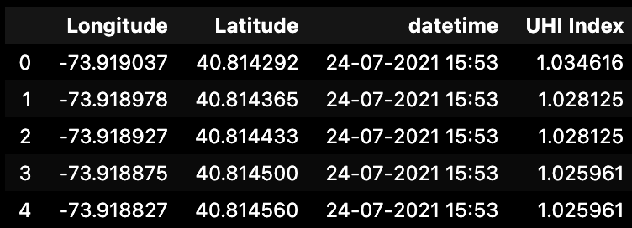
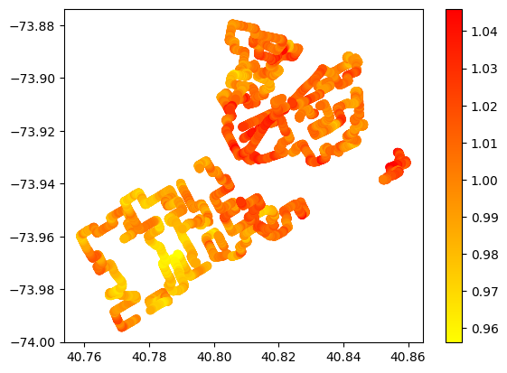
Recap from last meeting
Project Goal: We are looking to predict changes in temperatures within NYC, name ‘Urban Heat Islands’
Review of data: Access to satellite data which can be used in building models. Considering looking into NYC Open Data to include more features
Next Steps: Average income, heat conductivity of materials, weather data, use grid instead of long/lat

Slide 3
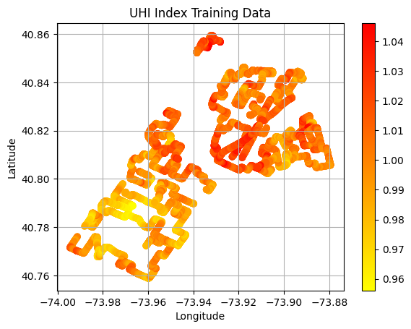
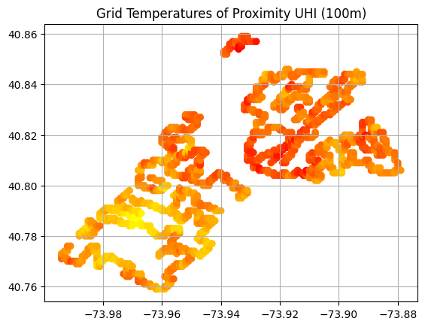
Granular (6 d.p.) vs Proximity Approach (3 d.p) for UHI Index
Notes:
In this we rounded longitude and latitude to 3 decimal places and plotted the average UHI at that point
This took the number of points from 11k to 1k which is why the graph is not as smooth

Slide 4
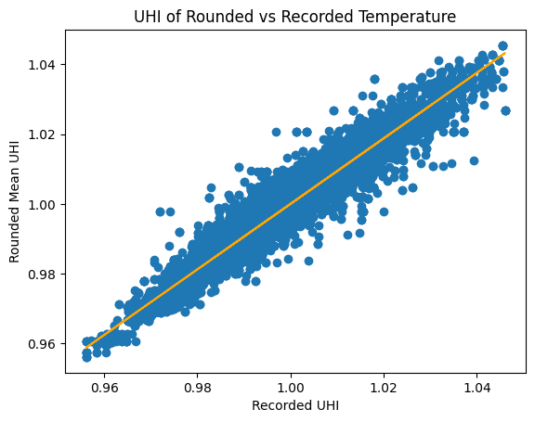
Two options for Model training (we are yet to do the proximity approach for UHI Values)
1: Proximity Training
R^2 = 0.94
2. Granular Training
We have done all of our models so far on granular training as this has been a new idea but we have been investigating different ways of doing.
cKDTrees is a data structure which has allowed us to map nearby points even if they are not the same long / lat (down to multiple decimal places)
Notes:
We are going to see if there is an improvement by rounding the UHI rather than having it as granular to try and make it a more general model that can be evaluated

Slide 5
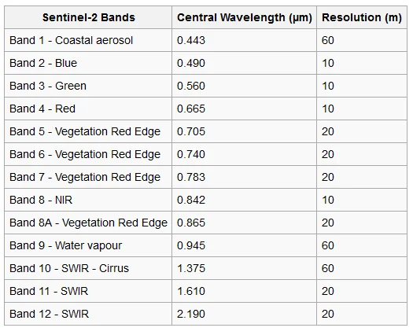
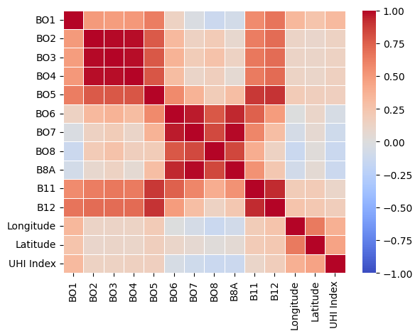
Data Available: Sentinel 2
Band combinations we will look to build into models:
Vegetation and Plant Health: NDVI = (B8 - B4) / (B8 + B4)
Vegetation and Water: NDWI: NDWI = (B3 - B8) / (B3 + B8)
Urban and Built Up: NDBI = (B11 - B8) / (B11 + B8)

Slide 6
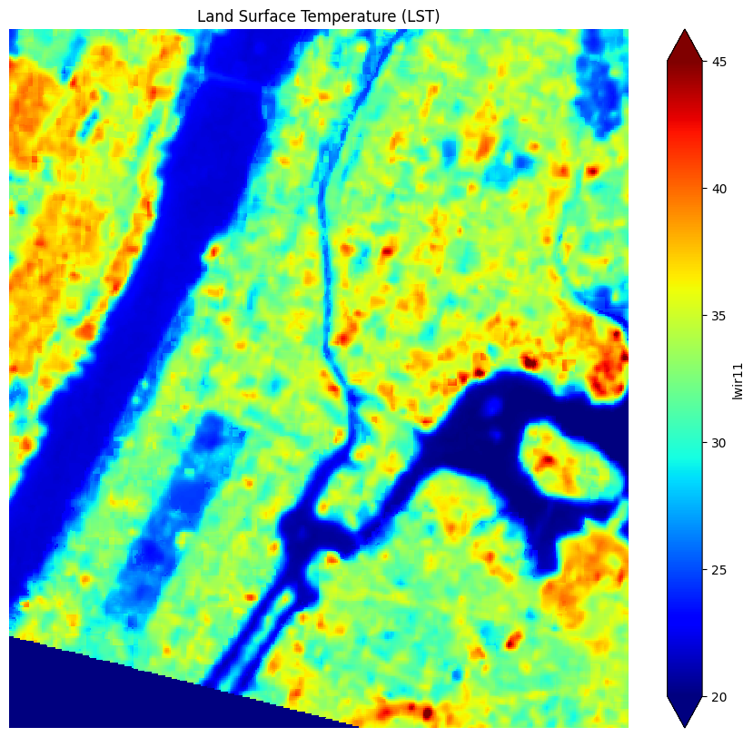
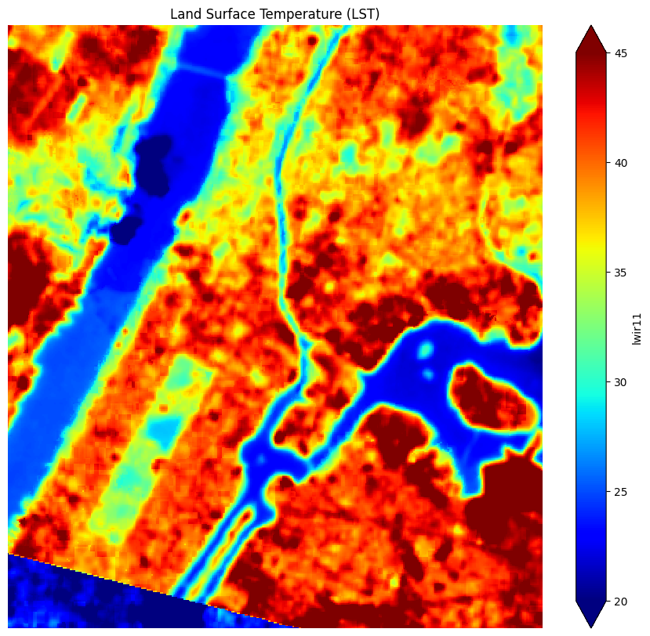
Data Available: Landsat Temperature
2021
2022

Slide 7
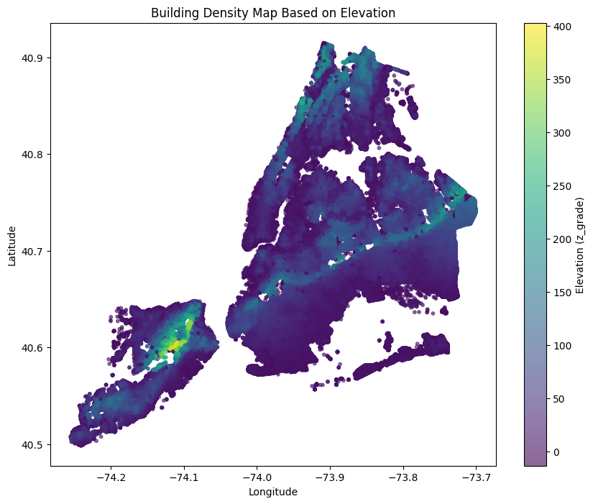
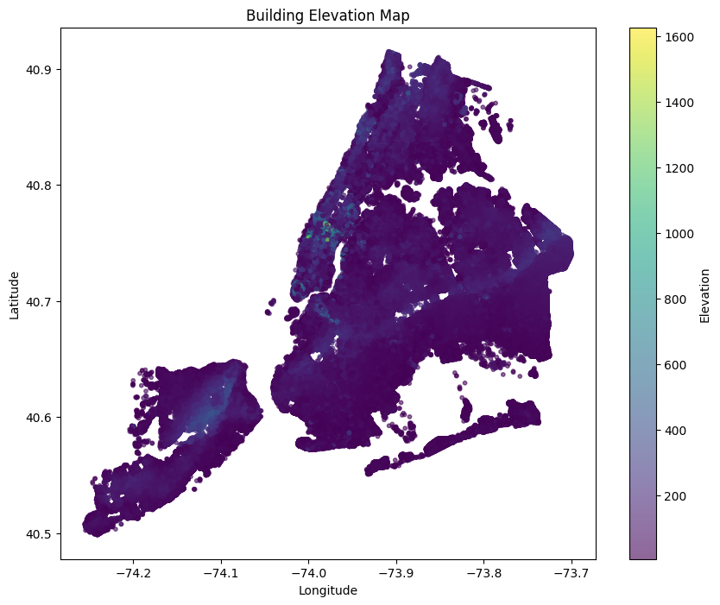
Data Available: Elevation/NYC Data
Building Data Collected
Planimetric Data

Slide 8
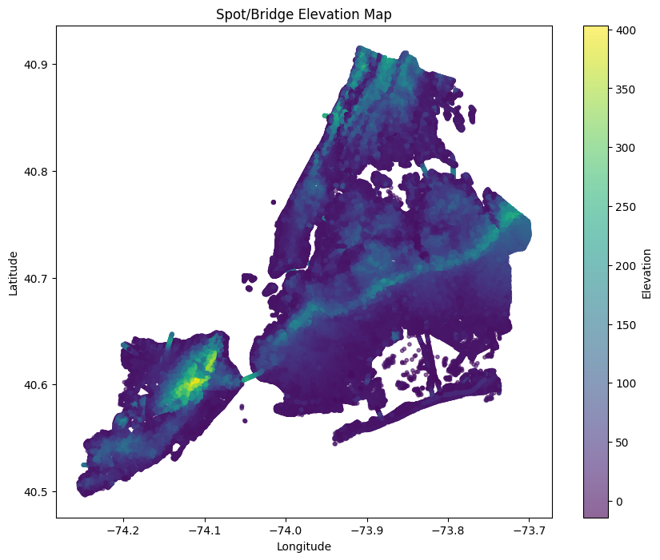
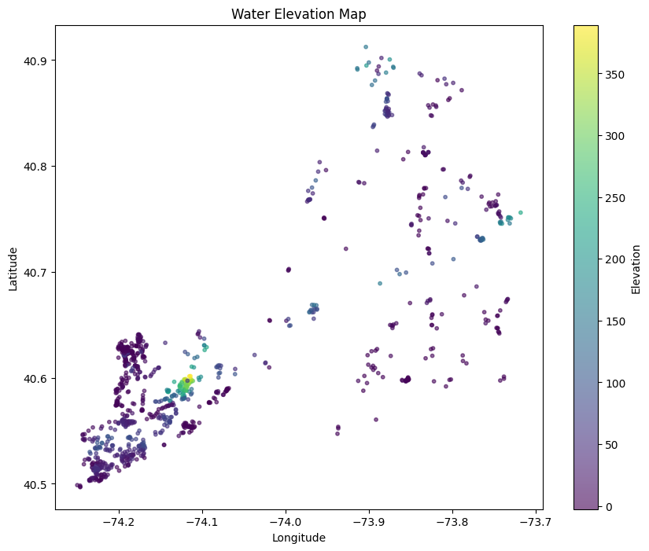
Other Elevation

Slide 9
Model Building
The bad models:
Linear Regression between different bands saw no more than a 0.05 R^2
Multiple Linear Regression had no more than 0.1 R^2 value
We have learnt:
This data has non linear complex patterns that needs more advanced ML models

Slide 10
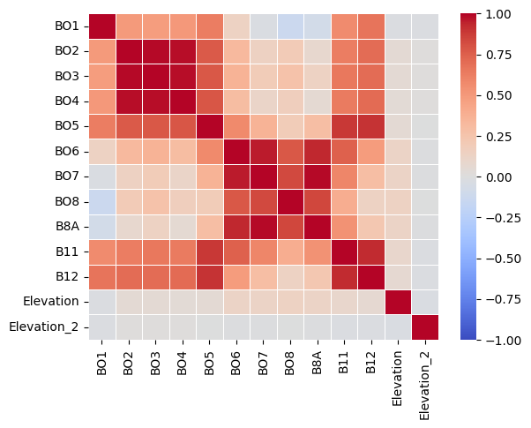
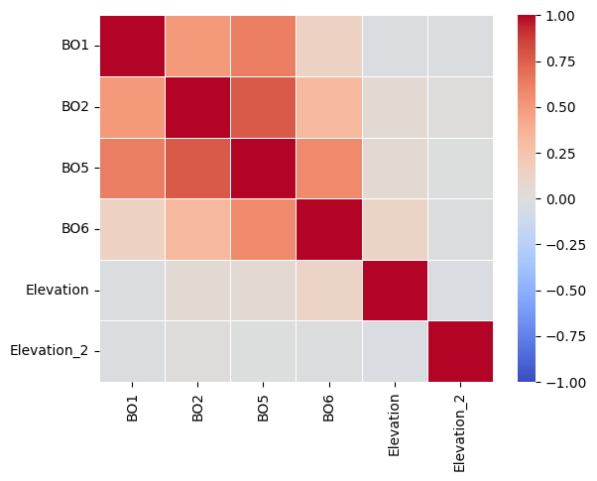
Model Building (Baseline RF)
Build a random forest with all columns vs high correlation matrix dropped.
This was a standard RF with default values in the scikit learn RandomForestRegressor() package
Max_depth: max
N_estimators: 100
Max_features: max
We got a R^2 of 0.71 for all column (train/test)
We got a R^2 of 0.75 for correlation dropped column (train/test)

Slide 11
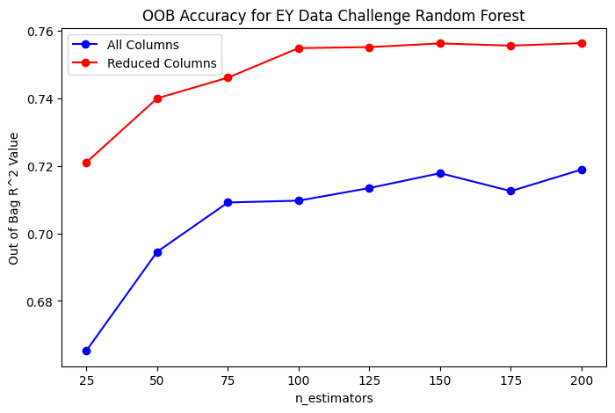
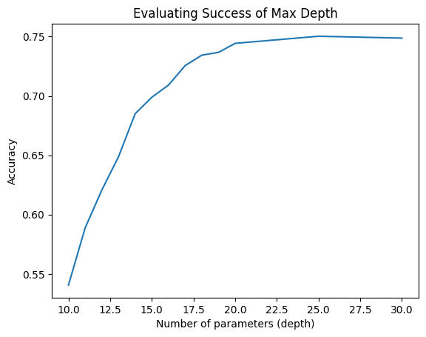
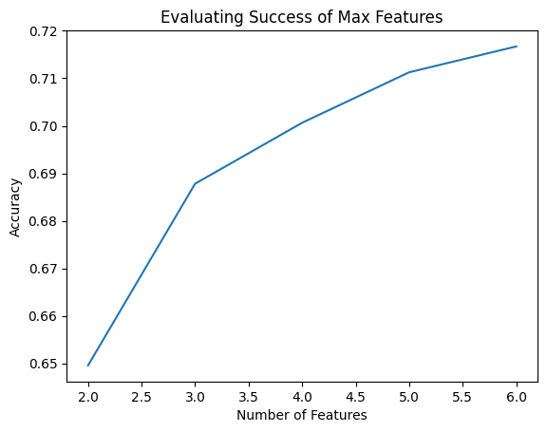
Random Forest Expanded: Hyperparameter Tuning
This is an exhaustive search - we plan on utilizing random grid search or Bayesian Optimization to streamline this process as we build more models
We compared reduced columns vs all columns and found reduced columns to perform far better

Slide 12
Random Forest Official Submissions
Using the elbow points of hyper parameter tuning:
Using bands ['BO1', 'BO2', 'BO5', 'BO6'] we got an R^2 of 0.6238
Using bands ['BO1', 'BO2', 'BO5', 'BO6',’Elevation] we got an R^2 of 0.6539
We are building a thorough jupyter notebook of how to build out a ML model to be able to look back on in the future

Slide 13
What’s next for the Random Forest Model
Data to include
Perform analysis on different mathematically created band values such as NDVI, NDWI, and NDBI and see which can be used in RF model
Incorporate Landsat surface temperature as a predictor
Train data on the proximity UHI values (more general might see better improvements in official submission)
Model improvement
Hyperparameter tuning: Bayesian Optimization, randomized grid search
Evaluation: k-fold CV,

Slide 14
Next Ideas for Model Building
Gradient Boosting: XGBoost, LightGBM, CatBoost
Convolutional Neural Network
Clustering?
Create buffering averages for the the band data/elevation/NYC open data to then train on the proximity data
Ensemble learning or stacking models: incorporate multiple models into one

